Slide 1
Machine Learning Model comparison using
Insurance Data
by Aditya AVS

Slide 2
Story
Given the dataset containing Life Insurance Data, use multiple models to predict the response which is a measure of risk in 8 level. Evaluate the model using possible model evaluation techniques.
Steps to be followed:
Data Cleaning and EDA.
Try out various machine learning models using train test and model evaluation techniques and choose the best model for output prediction. You may also use RandomisedSearchCV or GridSearchCV for hyperparameter tuning of the estimator at your own discretion.

Slide 3
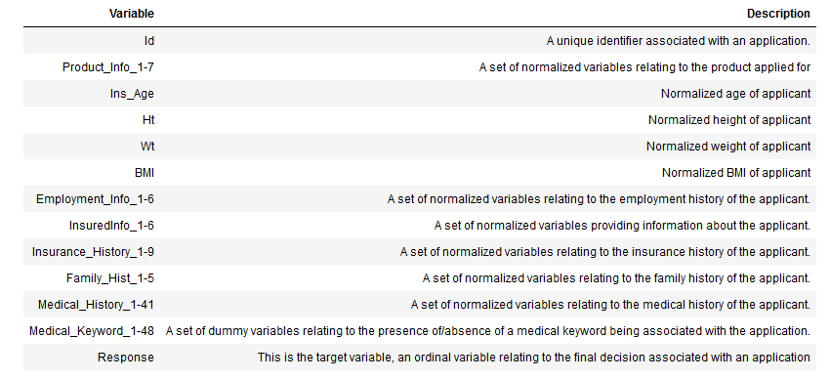
Data in depth

Slide 4
Problem Statement
Insurance has become an indispensable part of our lives in recent years and people are paying more attention on it. For this project, the data comes from prudential life insurance on kaggle with over a hundred variables describing attributes of life insurance applicants.
The challenging part for them is that the application process time is antiquated and the goal for this project is to help them to enhance the efficiency of processing time as well as reduce labour intensive for new and existing customers.
The task is to accurately predict the "Response" variable for each Id in the test set. "Response" is an ordinal measure of risk that has 8 levels.
We need to decide the best model for predicting the same by comparing various ML models.

Slide 5
Analysis
The following variables are all categorical (nominal):
Product_Info_1, Product_Info_2, Product_Info_3, Product_Info_5, Product_Info_6, Product_Info_7, Employment_Info_2, Employment_Info_3, Employment_Info_5, InsuredInfo_1, InsuredInfo_2, InsuredInfo_3, InsuredInfo_4, InsuredInfo_5, InsuredInfo_6, InsuredInfo_7, Insurance_History_1, Insurance_History_2, Insurance_History_3, Insurance_History_4, Insurance_History_7, Insurance_History_8, Insurance_History_9, Family_Hist_1, Medical_History_2, Medical_History_3, Medical_History_4, Medical_History_5, Medical_History_6, Medical_History_7, Medical_History_8, Medical_History_9, Medical_History_11, Medical_History_12, Medical_History_13, Medical_History_14, Medical_History_16, Medical_History_17, Medical_History_18, Medical_History_19, Medical_History_20, Medical_History_21, Medical_History_22, Medical_History_23, Medical_History_25, Medical_History_26, Medical_History_27, Medical_History_28, Medical_History_29, Medical_History_30, Medical_History_31, Medical_History_33, Medical_History_34, Medical_History_35, Medical_History_36, Medical_History_37, Medical_History_38, Medical_History_39, Medical_History_40, Medical_History_41
The following variables are continuous:
Product_Info_4, Ins_Age, Ht, Wt, BMI, Employment_Info_1, Employment_Info_4, Employment_Info_6, Insurance_History_5, Family_Hist_2, Family_Hist_3, Family_Hist_4, Family_Hist_5
The following variables are discrete:
Medical_History_1, Medical_History_10, Medical_History_15, Medical_History_24, Medical_History_32
Medical_Keyword_1-48 are dummy variables.

Slide 6
Imputing Missing Data
The following columns had missing data so, the ones with huge missing data were dropped and the others were analysed for outliers.
For data with huge outliers, Median value was used for replacing and Mean otherwise.
Employment_Info_1 19
Employment_Info_4 6779
Employment_Info_6 10854
Insurance_History_5 25396
Family_Hist_2 28656
Family_Hist_3 34241
Family_Hist_4 19184
Family_Hist_5 41811
Medical_History_1 8889
Medical_History_10 58824
Medical_History_15 44596
Medical_History_24 55580
Medical_History_32 58274

Slide 7
EDA
The Response column data had more values closing to Level 8 indicating majority of the applicants fall in this category.
Also, the response value was higher for lower insured age and it decreased with age. This indicates that the people with lower age were preferred compared to old people.
Also, Insured Age seems to be tending to a normal distribution with insurance age between 20 – 60 being max.
Also, people with less (not low) weight have higher response level. Same goes for BMI.
This gives us an indication that they prefer healthy people to provide the insurance.

Slide 8
ML Models used
Tried the following models:
Linear Regression
Logistic Regression
Decision Tree Classifier
Random Forest Classifier
Default Parameter Model
Customized Parameter Model
random_state = 0,
max_depth = 8,
min_samples_leaf = 5,
min_samples_split = 7,
min_weight_fraction_leaf = 0.0,
max_features = 'sqrt',
n_estimators = 50,
oob_score = True,
n_jobs = -1
The Regression models do not do a good job here as this is more of a classification problem.
So, the classifier models have been compared.

Slide 9
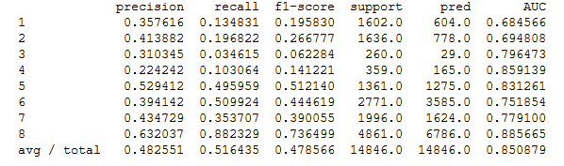
Model Evaluation
Decision Tree Classifier

Slide 10
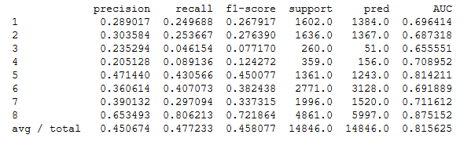
Model Evaluation
Random Forest Classifier – Default Param

Slide 11
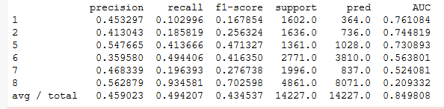
Model Evaluation
Random Forest Classifier – Customized Param

Slide 12
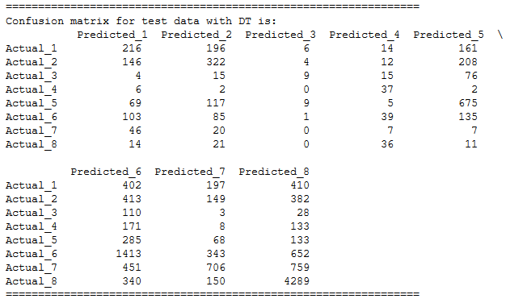
Confusion Matrix of Decision Tree Classifier
Since this is not a binary data but multiclass data that has 8 level prediction.
actual vs. predicted are given per response level.
All the three models are close in terms of predicting the response levels
In Random Forest Model 2, there seem to be a more number of False Positives and it's getting the higher response levels(Actual 1 but Predicted 8 cases). Also for Levels 3 and Level 4, there is no prediction at all.
In Model 1 and DT, it is more spread out with Decision Trees doing a better job with lesser number of false positives

Slide 13
Conclusion
We have compared the performance of the models using various model evaluation techniques.
Our objective is to precisely predict Response so that life insurance applications can be scrutinized easily and correct decision be made.
Judging all the factors including AUC and Confusion Matrix, Decision Tree Classifier model is more suitable for this dataset.
But Random Forest Classifier Model 2 also does a very good job.
If we can tweak it further, it might also help us. But the flaw in that model is that the number of false positives (Response Level 8 when Actual is not so) is more in number.

